Slide 1
So You Think You Want To Go To Graduate School
SPS Presentation, September 24, 2025

Slide 2
Why go to physics graduate school?
Academic career: teaching/research job at college or university
Research career at national lab or government agency
Research/development career in private sector (industry, health care, finance, etc)
Do it for the right reasons! Earning the largest possible amount of money is not one of them!

Slide 3
Pluses and Minuses of Academic Careers
Freedom, autonomy in choosing what to work on
You do what you love
Job stability IF you make it to a tenured faculty job
Flexible schedules
Much lower salaries than in industry
Long period of job instability in early career
Tough competition for permanent jobs (“publish or perish” )
Little control over location of permanent job

Slide 4
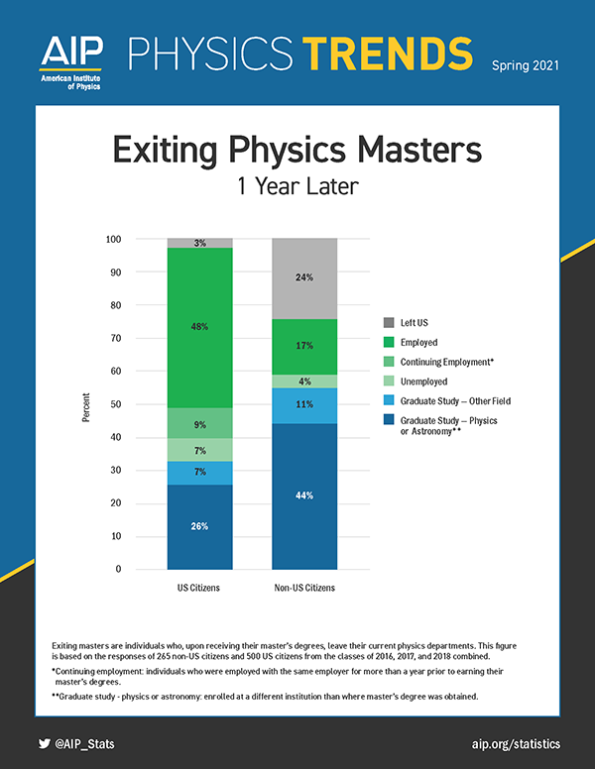
MS vs. PhD degrees
In physics, MS usually not considered terminal degree
MS is either steppingstone to PhD program or path to private sector
PhD is required for academic careers or national lab careers

Slide 5
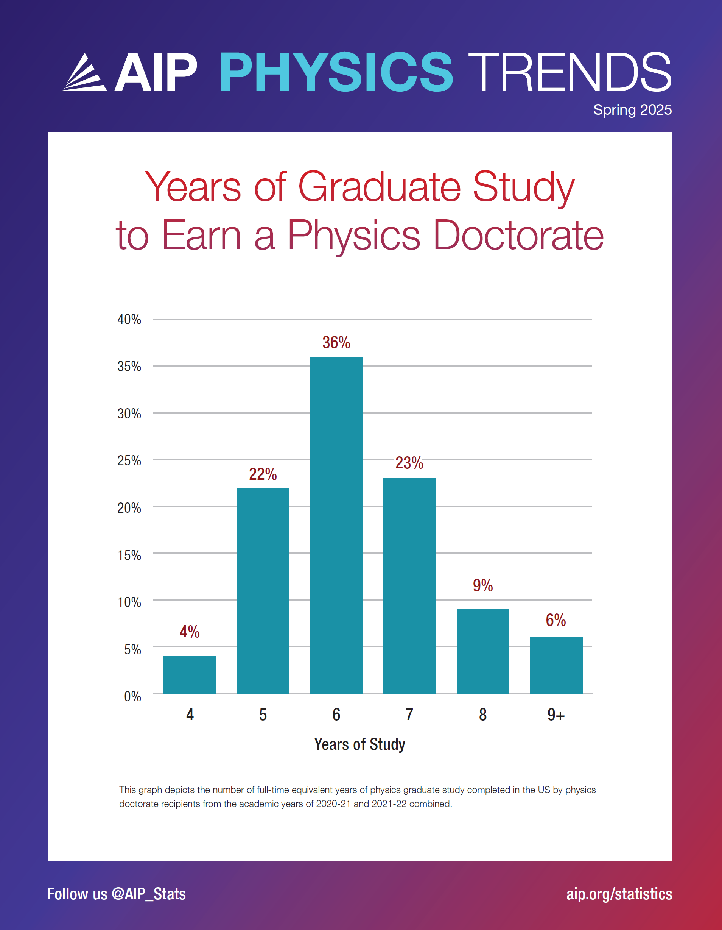
PhD careers
Average time to PhD from the BS degree is 6+ years in the US
May require one or more postdoc positions before permanent job (10+ years beyond BS)
May require frequent relocation

Slide 6
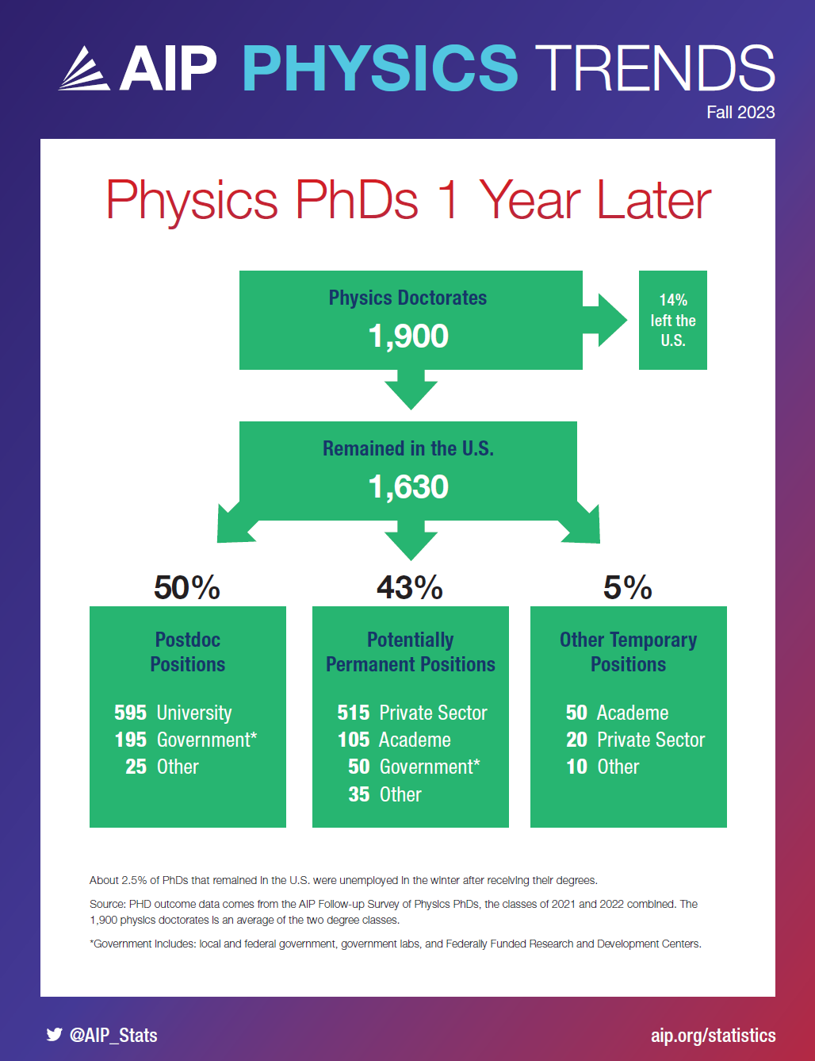
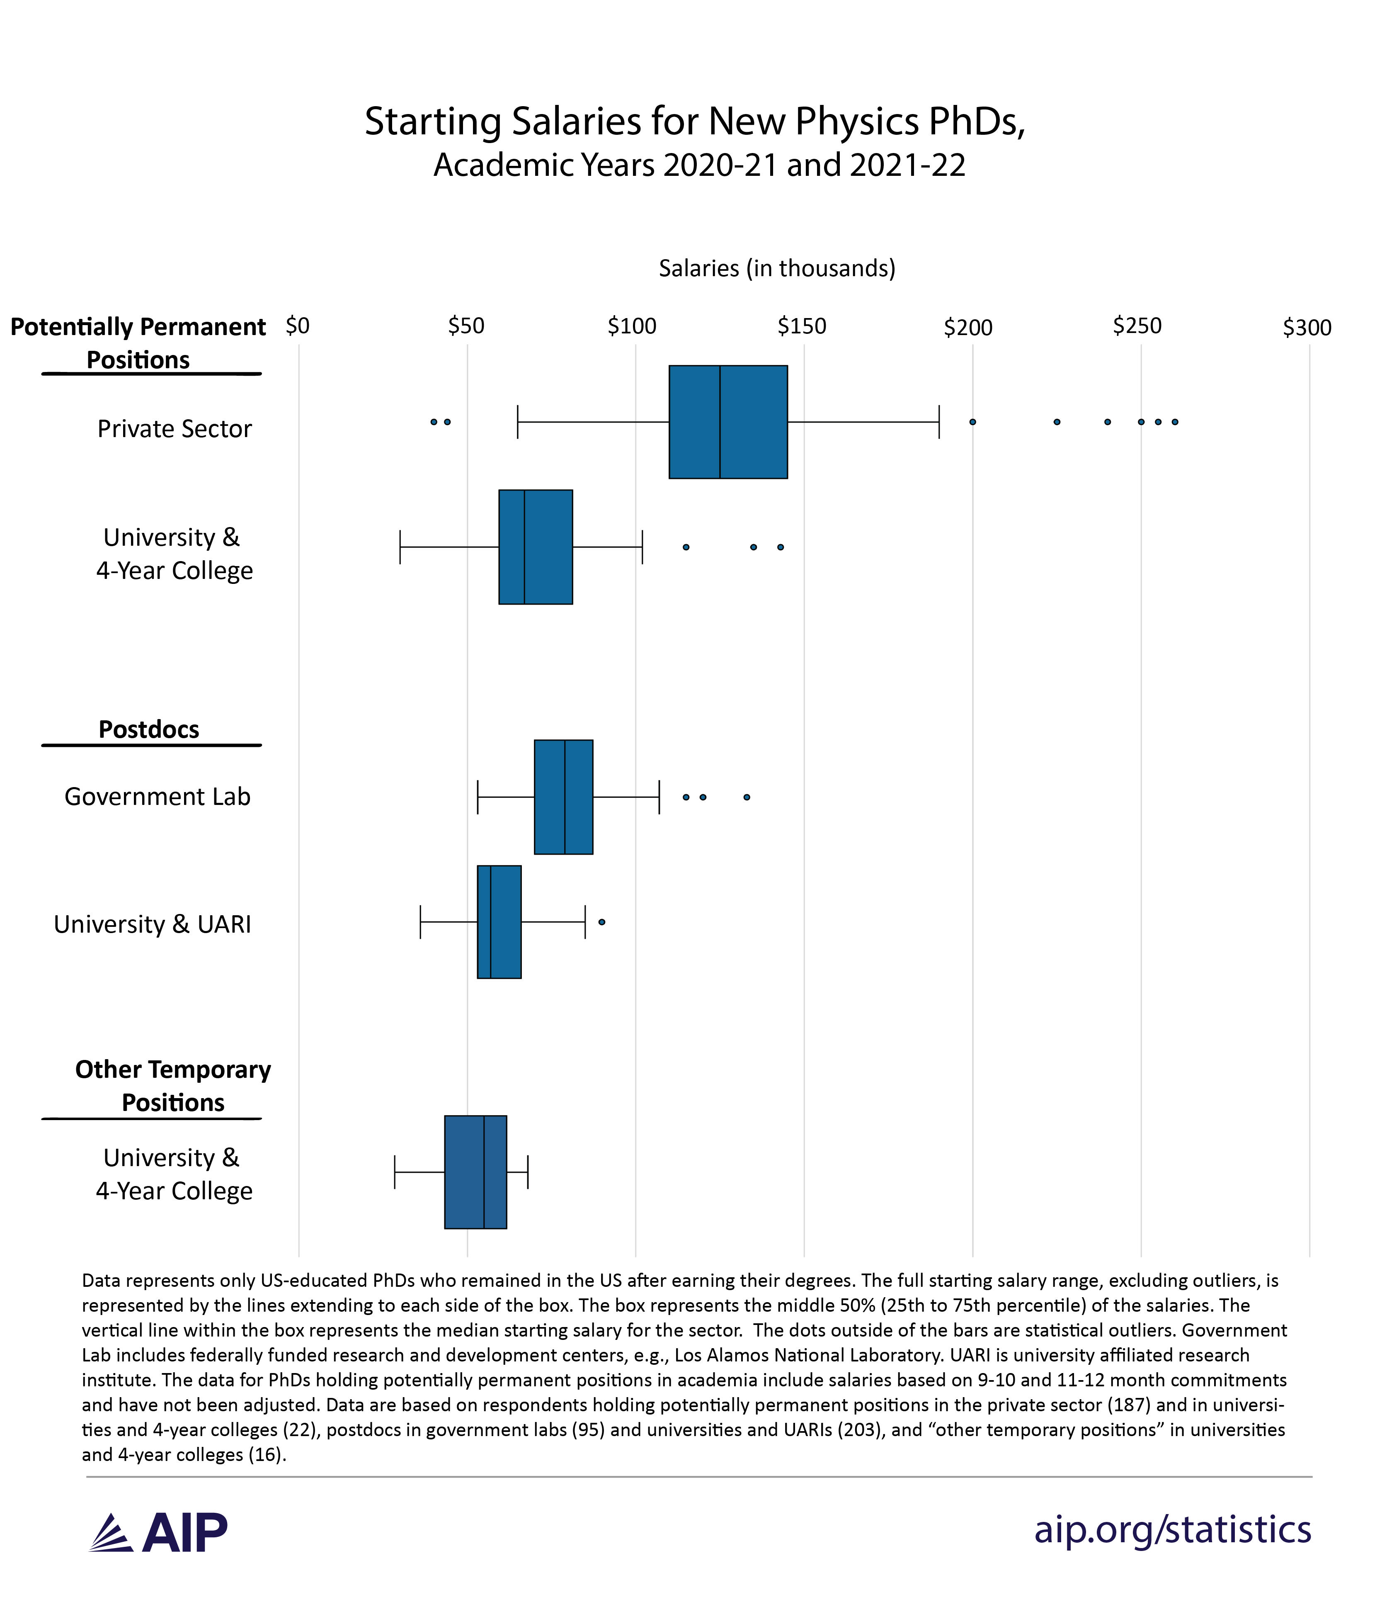

Slide 7
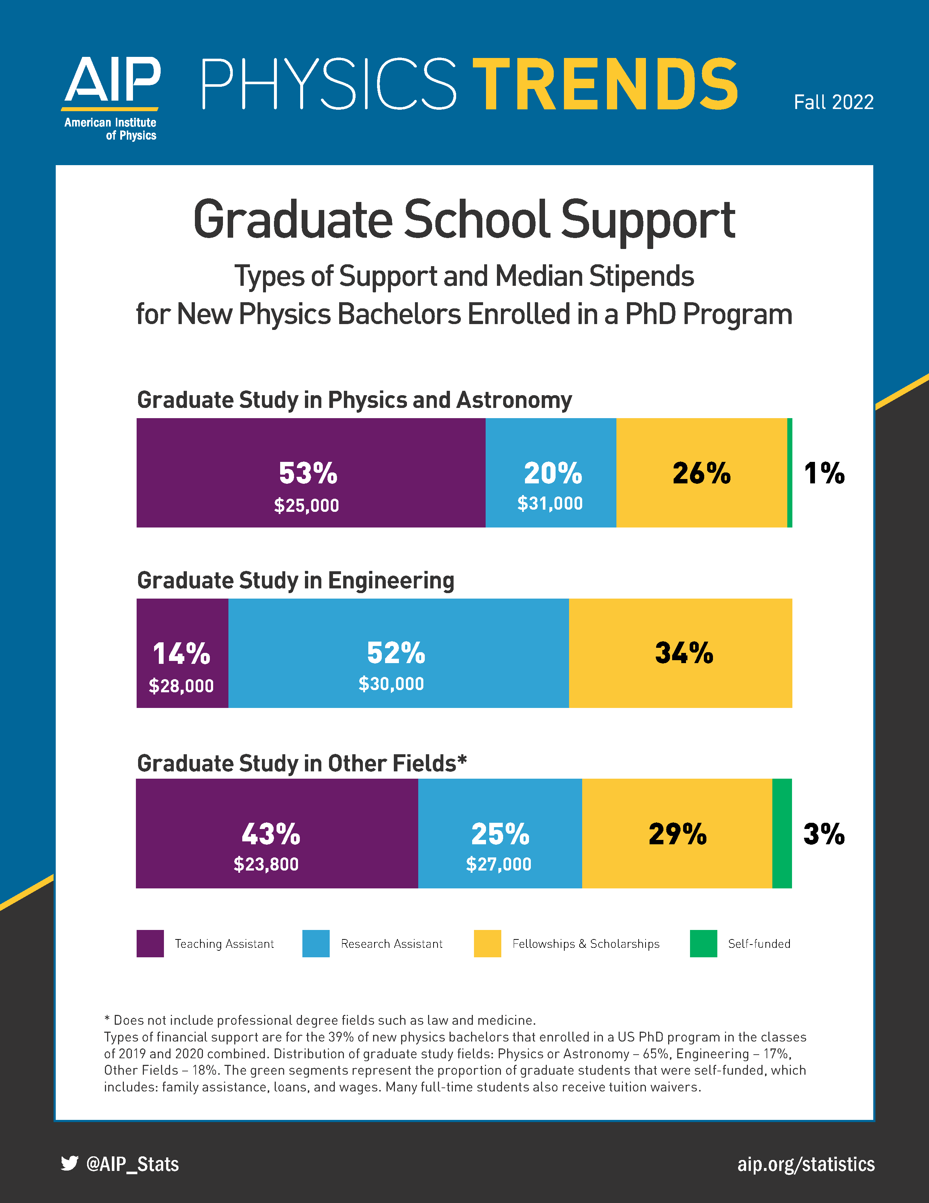
How to fund graduate school?
Physics PhD students are usually fully funded (tuition waiver + 50% FTE assistantship)
Often first teaching assistant, later research assistant
Stipend amounts vary somewhat between schools, but not dramatically
Terminal MS students often not fully funded

Slide 8
How to pick a graduate school?
Not all graduate programs are created equal: different research focuses, different caliber of faculty and students
PhD is a research degree, need to specialize in one area and in theory vs. experiment
Pick school that matches your interests (but do not count on working with particular professor)
Participate in undergraduate research, attend colloquia, do REUs to find out what kinds of research you like and are good at

Slide 9
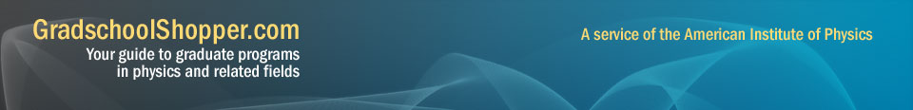
Resources For Choosing Graduate Schools
Gradschoolshopper.com (from AIP)
AIP Graduate Program Book
Physics department websites (look at faculty pages)
Talk to S&T faculty
Graduate school rankings (subjective!)

Slide 10
Missouri S&T physics graduate programs
PhD and MS (with and without thesis) degrees
PhD requires 72 credit hours, MS 30 credit hours
Grad Track Pathway: accelerated program, graduate courses taken as part of BS degree also count towards MS degree (plan to expand to PhD).
PhD students fully funded by TA/RA position (department brings in about 5 new TAs each year)
Thesis research in astrophysics, AMO physics, or condensed matter physics
Contact Drs. Fischer (grad admissions) or Chernatynskiy (grad advisor)

Slide 11
Application materials
Transcript (from Registrar’s Office http://registrar.mst.edu/transcripts/trans/)
Statement of Purpose (or something equivalent)
Resume
Letters of recommendation (usually 3)
GRE (general and often also subject) – used to be required
Now, GRE optional for many programs, some do not even consider it! Currently, GRE required for less than 20% of physics PhD programs (but situation is fluid)
Absence of GRE puts more weight on the other materials!!!

Slide 12
Statement of purpose
Typically no more than 2 pages (often a length limit)
Shorter generally better
Who you are, why you want to go the grad school, why you want to go to that particular school, what you want to do with your degree
Answer all questions asked in the call for applications
Get it proofread!!
Put some thought and effort into this!!

Slide 13
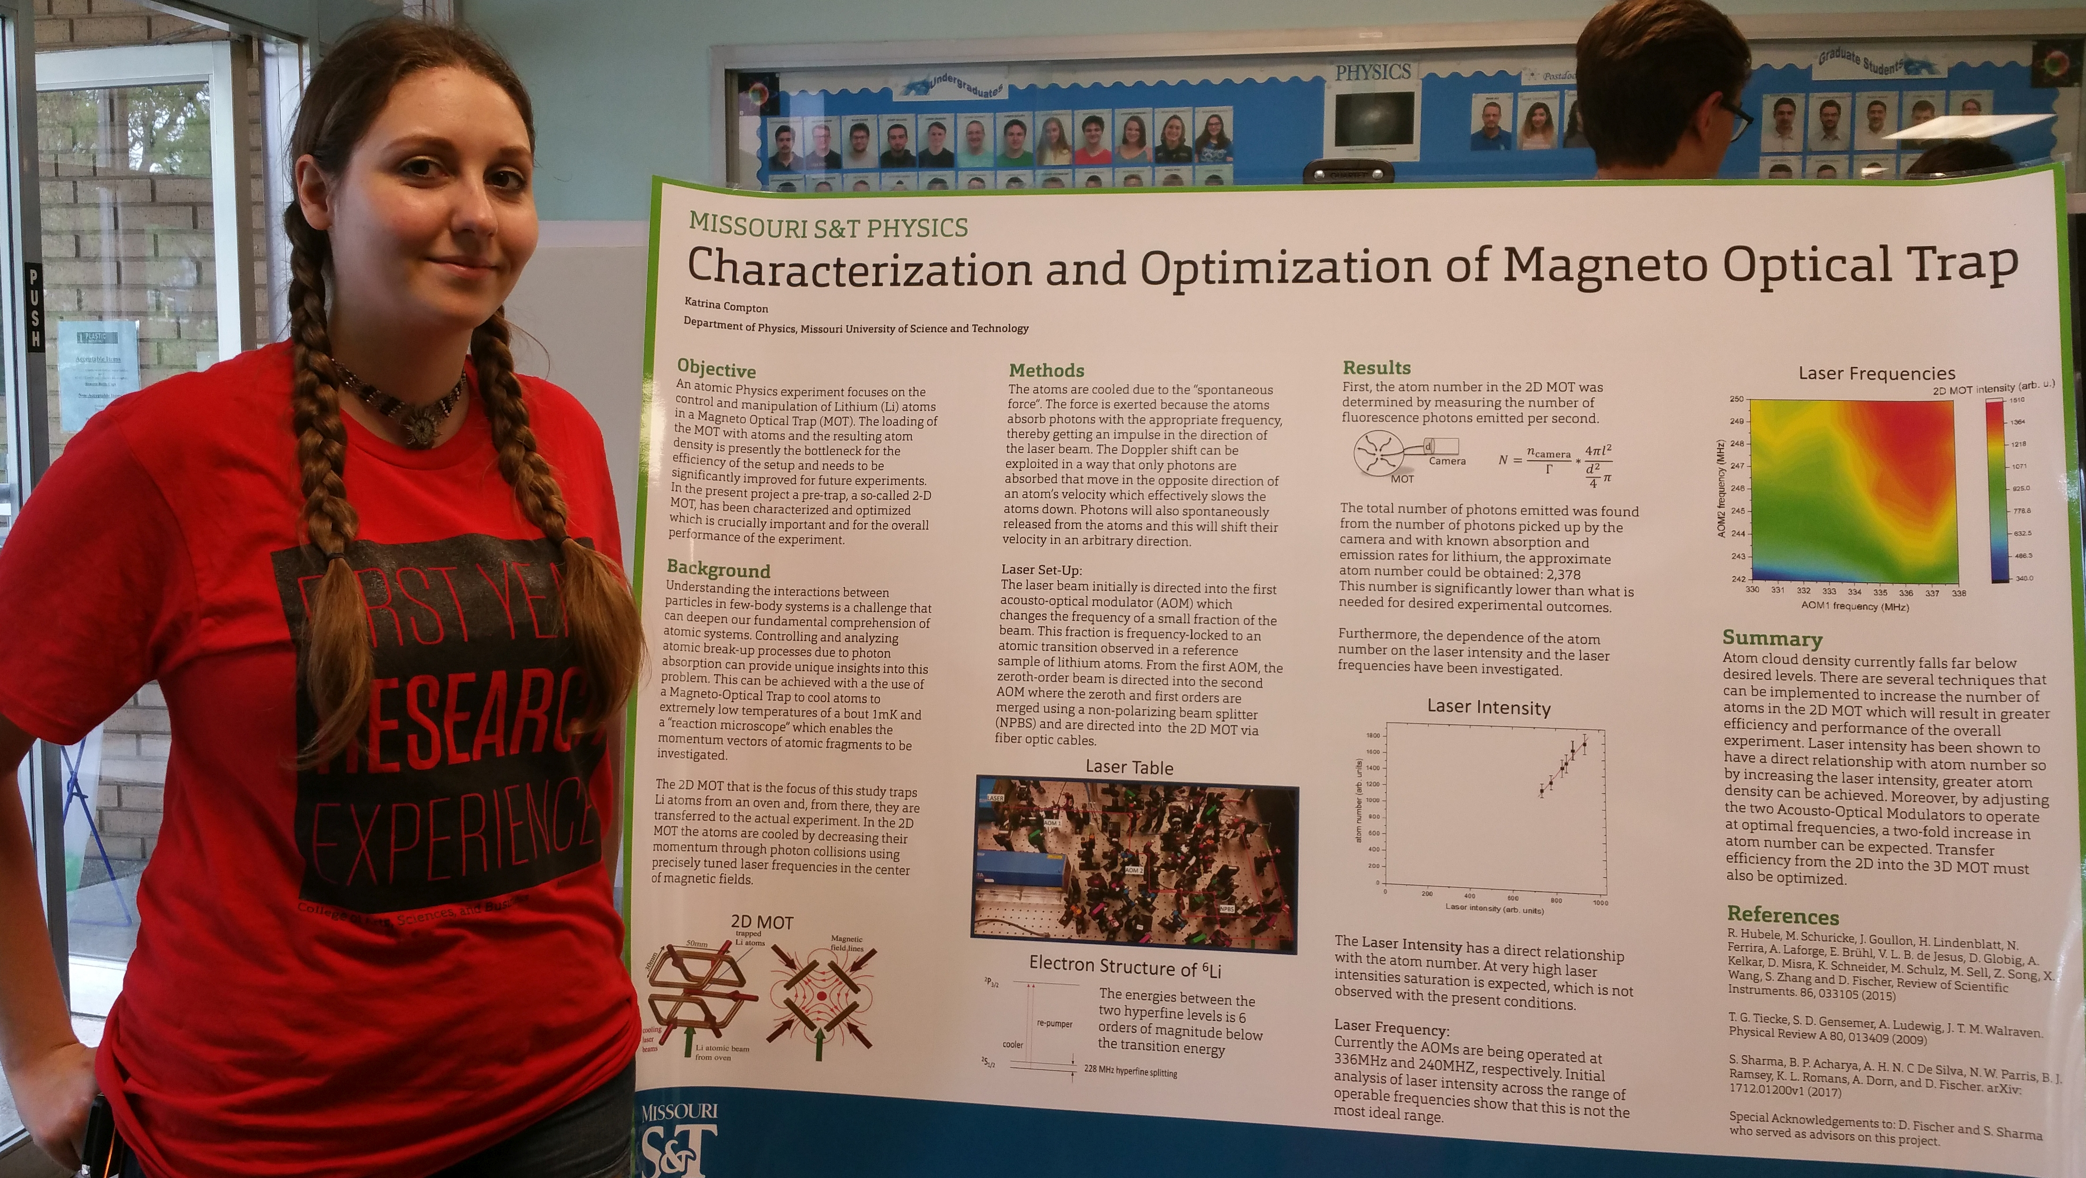
Letters of recommendation
Crucial for success, especially for competitive programs
You want strong, specific letters rather than generic one’s (“student came to class and got an A”)
Need to come from faculty who know you well, research advisors usually better than course instructors
Foster relationships with faculty early!
Make requests in person + discuss your plans!
Provide CV and application materials !
Leave plenty of time before the deadlines!

Slide 14
Strategies for applying
Choose 5-6 schools (applications are costly)
List should have 2-3 “dream” schools, 2-3 schools matched to your performance level, and 2-3 “safe” schools
If you aren’t sure about area, target schools with strength in multiple areas
Fall admissions are more common than spring admissions
Application deadlines generally Dec. and Jan. for Fall admission)
Applications for Fall semester are acted on between Jan.-April of that year

Slide 15
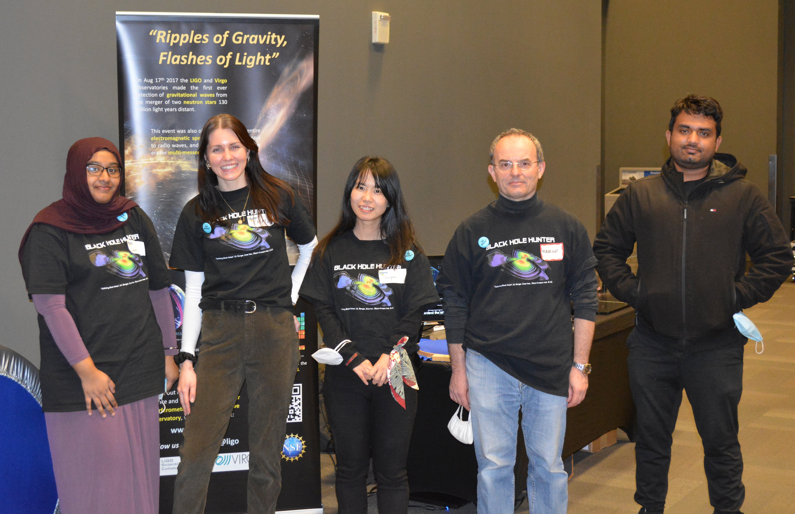
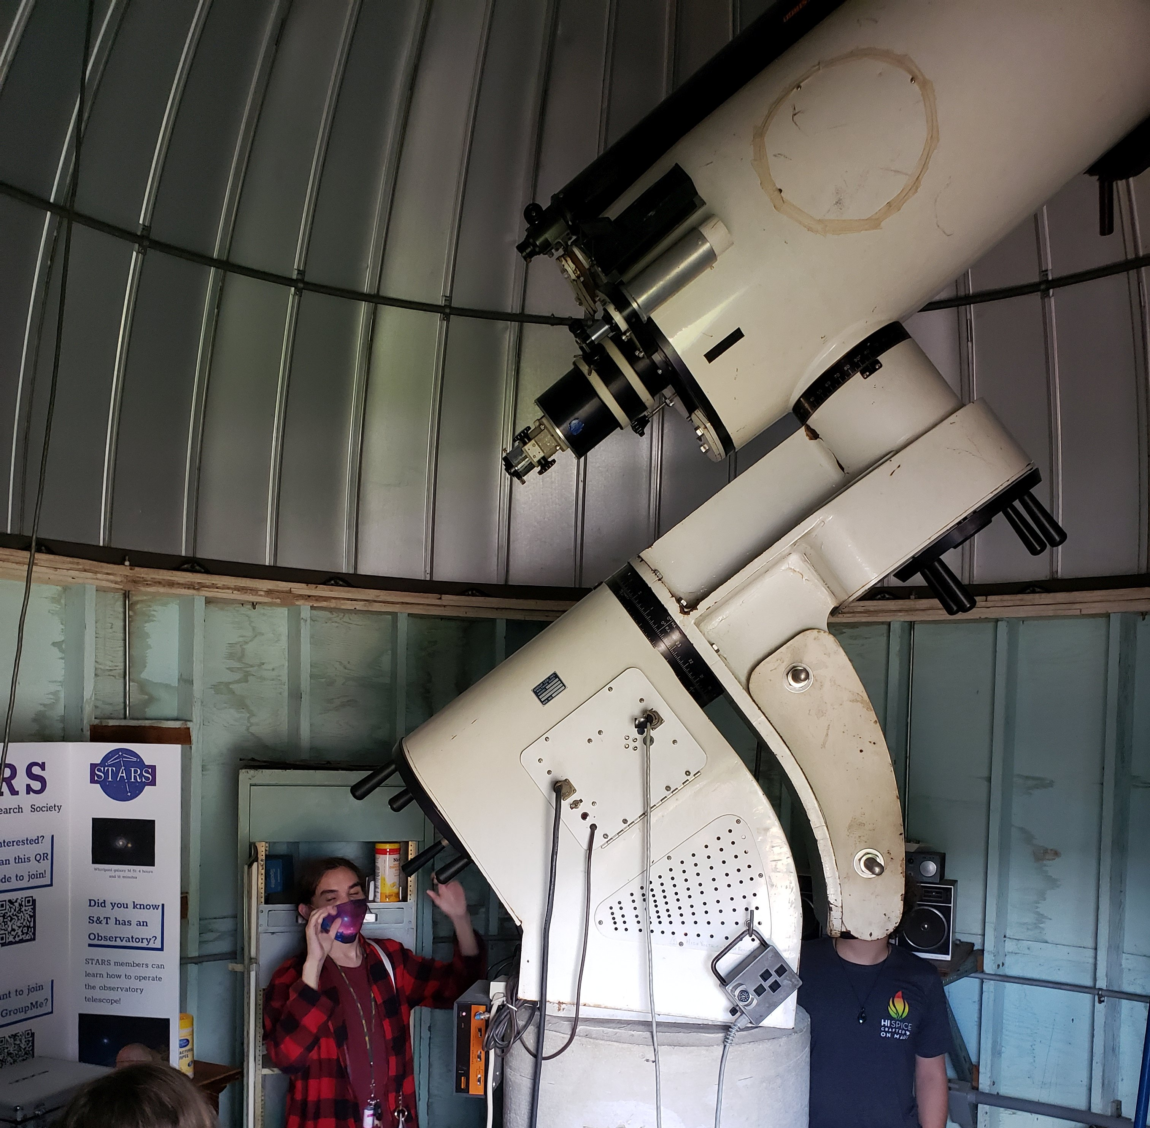
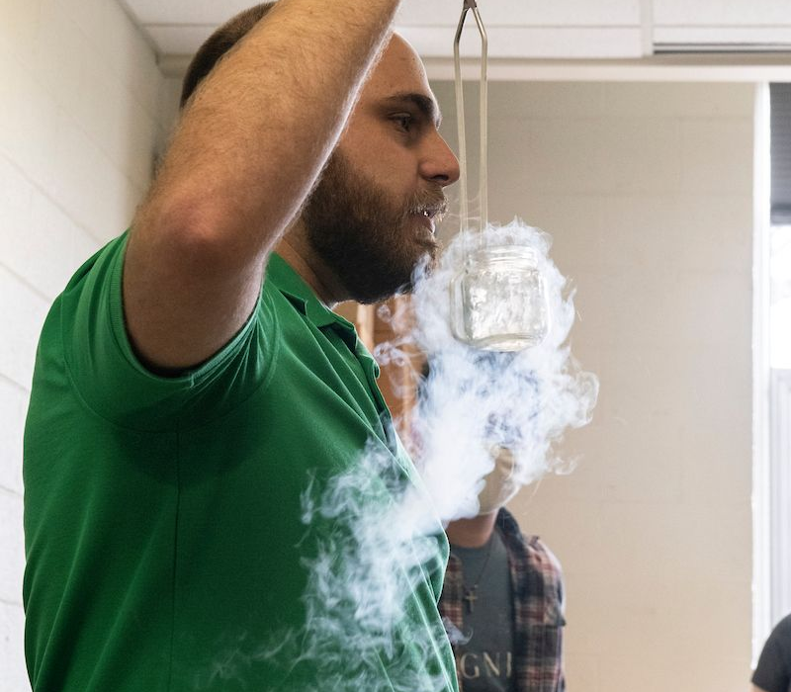
Helping your chances
Do well academically
Undergraduate research (locally and in REUs)
Get involved in SPS and other student organizations
Foster relationships with faculty for future letters of recommendation
Consider applying for Graduate Fellowships (NSF, DOD, Hertz, etc)

Slide 16
Timetable
Junior year and earlier: Discussions with faculty about grad studies, undergraduate research, summer programs (REUs etc)
Summer between junior and senior years: Decide whether or not and when to take GRE, start collecting info on graduate programs and fellowship opportunities
Fall semester of senior year: Ask faculty for letters at beginning of fall term, have application materials ready by mid-November, take GRE, send applications
Spring semester of senior year: Watch for confirmations that application materials and letters have been received, consider visiting schools on your list, compare acceptances/offers of support that you receive
Deadline for acceptance usually April 15 (April 15 resolution)

Slide 17
Additional Resources
https://www.aapt.org/Resources/upload/Planning-for-Graduate-Studies-PDF.pdf
https://www.aps.org/webinars/
https://aps.org/careers/guidance/webinars/gradus.cfm
https://docs.google.com/spreadsheets/d/19UhYToXOPZkZ3CM469ru3Uwk4584CmzZyAVVwQJJcyc/edit#gid=0 (list of institutions and GRE requirements)

Slide 18
Graduate Record Examination (GRE)
General GRE is available at Rolla Testing Center
Registration fee is $220
Included in fee are free reports to 4 graduate programs (additional reports are $35 each)
Information and Registration Bulletin at http://www.ets.org/gre/revised_general/about

Slide 19
Preparing for general GRE
Verbal Reasoning - measures your ability to understand what you read and how you apply your reasoning skills.
Quantitative Reasoning - measures your ability to understand quantitative information, interpret and analyze quantitative information, solve problems using mathematical models, apply basic mathematical skills and elementary mathematical concepts of arithmetic, algebra, geometry, probability and statistics.
Analytical Writing - measures your ability to articulate complex ideas clearly and effectively, support ideas with relevant reasons and examples, examine claims and accompanying evidence, sustain a well-focused, coherent discussion, control the elements of standard written English
Example questions and free test prep material at http://www.ets.org/gre/revised_general/about/content/

Slide 20
Subject GRE - Physics
Available at MSU (Springfield), perhaps S&T?
Subject GRE available Sept. , Oct. , and April
Registration deadline ~1 month prior to exam
Registration fee is $150
Included in fee are free reports to 4 graduate programs (additional reports are $35 each)
https://www.ets.org/gre/test-takers/subject-tests/about.html

Slide 21
Preparing for Physics GRE
Approximately 100 multiple choice questions
Classical Mechanics (20 %) – Phys 1135 and 3201
E&M (18%) – Phys 2135, 3211, and 4211
Optics & Wave Phenomena (9%) – Phys 2135 and 4503 (elective course)
Thermodynamics and Statistical Mechanics (10%) – Phys 1135 and 4311
Quantum Mechanics (12%) – Phys 2305 and 4301
Atomic Physics (10%) – Phys 2305
Special Relativity (6%) – Phys 2305
Laboratory Methods (6%) – Phys 1135, 2135, 2129, 3119, and 3129
Specialized Topics (9%) – Phys 2305, 3311, 2401, and misc. elective courses
Free test prep material at https://www.ets.org/gre/test-takers/subject-tests/prepare.html

